Slide 1
Product Sentiment Analyzer
Ramchandra Bobhate
Project Intern, IBM Cloud and Cognitive Software
Prachi Ayare
Project Intern, IBM Cloud and Cognitive Software

Slide 2
Agenda
Concept
Scope of Work
Technology
Demo
Limitations

Slide 3
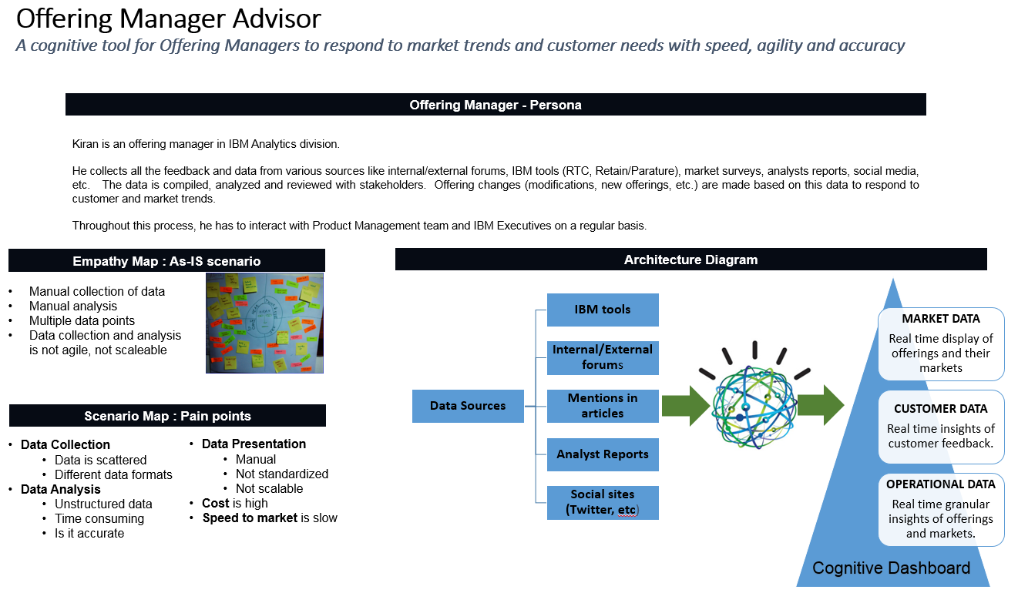
Concept

Slide 4
Scope of Work
Product Sentiment Analyzer - A cognitive tool for offering managers to conduct the mood assessment
Data source used - Twitter

Slide 5
Technology
PHP / Python Flask
Twitter Search API (Standard version)
IBM Watson Natural Language Understanding
IBM Cloud

Slide 6





WORKING (BLOCK DIAGRAM)
Positive
Enter text to be searched
Neutral
PSA APP
Find out tweets using twitter API
Negative
Apply NLU Watson API
Display Results
OM

Slide 7
Demo time !

Slide 8
Limitations
Standard Twitter API has been used
Twitter display text: limited to 140 characters
Displays 7 days data using standard twitter API
Maximum 100 tweets are allowed to collect
UI performance slowness

Slide 9
Learning
Development of application end-to-end
UI
Backend
Build
Test
Usage of IBM Cloud
Usage of two technologies

Slide 10
Thank You
Mentors
Pallavi Singh
Anunay Kumar
Xlence Team
Sheetal Atha
Ankitha Patil

Slide 11


